Slide 1


Linux operating system v.eSHWAR

Slide 2
What is Linux?
Linux is an open-source, Unix-like operating system created by Linus Torvalds in 1991.
It’s the engine behind most of the internet, powering:
Websites
Smartphones (Android is based on Linux)
Supercomputers
It’s free to use, modify, and distribute!

Slide 3
Why Use Linux?
Free & Open Source-No license costs. Modify as you like.
Secure, Stable, and Fast– Rarely crashes. Built with security in mind
Widely used in Cloud, DevOps, and Servers
Performance-lightweight and fast even on old machines.
Used Everywhere – From cloud servers to IoT to Android.
3

Slide 4
Linux Distributions:
Linux comes in different distros – pre-built versions with tools and user interfaces.
Examples:
Ubuntu: Best for beginners and developers
CentOS/RHEL: Used in enterprises and servers
Debian: Rock-solid and stable
Kali Linux: Designed for cybersecurity professionals
4

Slide 5
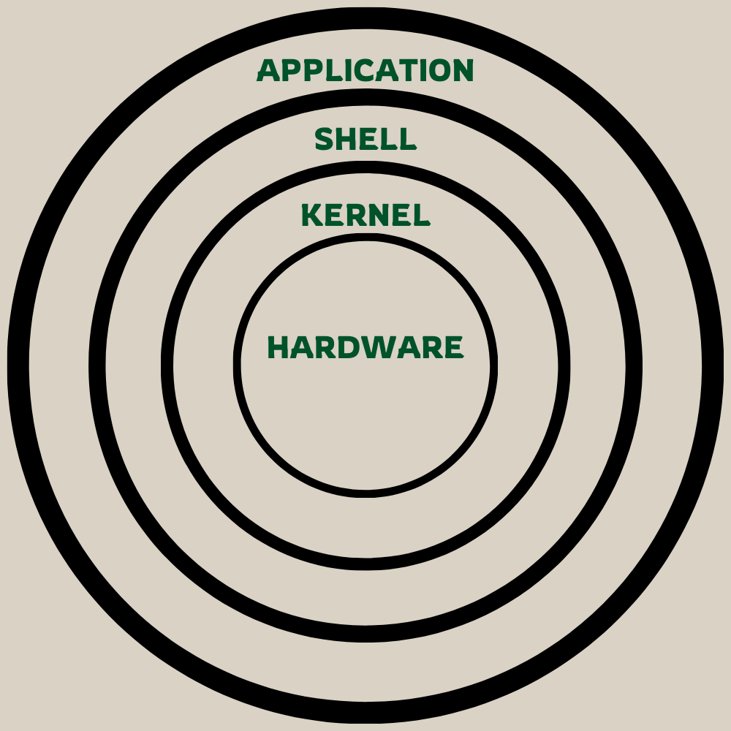
Linux Architecture (Simple View):
[ Applications ]- Software you use (e.g., browsers, tools)
[ Shell ]-Takes your commands and sends them to the OS.
[ Kernal ]- Heart of Linux, talks to hardware
[ Hardware ]-CPU,RAM, motherboard
Kernel manages resources
Shell acts as interface
Applications run on top
5
5

Slide 6
The Linux Command Line:
Basic commands:
ls-list the files
Cd-to change the directory
Pwd, cp, rm, mkdir,etc.
CLI is fast, efficient, and scriptable
6
6

Slide 7
Linux Permissions & Ownership:
Every file has:
Owner – who created it
Group – team access
Others – everyone else
Permissions: r(read),w(write),x(execute)
Commands: chmod, chown, ls -l
This system keeps Linux secure and collaborative.
7
7
7

Slide 8
Package Management:
Easily install and update software:
Ubuntu : sudo apt install nginx
Centos: sudo yum install httpd
Arch: sudo pacman -S firefox
Package managers keep your system updated and clean.
8
8
8
8

Slide 9
Networking in Linux:
Powerful networking tools:
Ping- check connectivity
Ssh-remote login
scp- copy files over network
ifconfig-manage interface, ip, netstat
Used for remote login, file transfer, server monitoring
9
9

Slide 10
Linux for Developers
Preferred by developers
Built in compilers and interpreters
Git,docker, python, java, node.js
Supports automation, scripting, and CI/CD pipelines
10

Slide 11
THANK YOU

